Slide 1
Attic Sensors
A Fun Raspberry PI/C++/Sensor Project To Monitor My Attic.
Dennis Glatting, October 2019
RevA

Slide 2
Object Structures Overview
Dev
Micro Dot pHAT
ADS1015
Si7021
IS31FL3730
The object structures are straight-forward. The Dev class is a base class from which i2c device classes are derived. The Micro Dot pHAT class encapsulates three is31fl3720 instances to form a Primoroni Micro Dot pHAT - a six character dot matrix display.

Slide 3
Hardware Overview
AdaFruit Si7021
Vdd
Raspberry Pi 3B
AdaFruit ADS1015
MQ9
GND
MQ7
Primoroni Enviro pHAT
MQ6
MQ4
ADS1015
Primoroni Micro Dot pHAT
MQ3
Notes: 1, Only the Enviro pHAT’s A/D converter is used. The pHAT was a spare part that I had laying around.
2, The Micro Dot pHAT was used for play. The sensors are located in my attic where no one will ever see them.
3, The unused inputs on the second A/D converter are connected to GND and Vdd. Originally, I thought I might use full-scale A/D voltage readings to adjust sensor readings. I also thought I might use temperature and relative humidity to adjust sensor readings, too. Didn’t do it.
MQ2

Slide 4
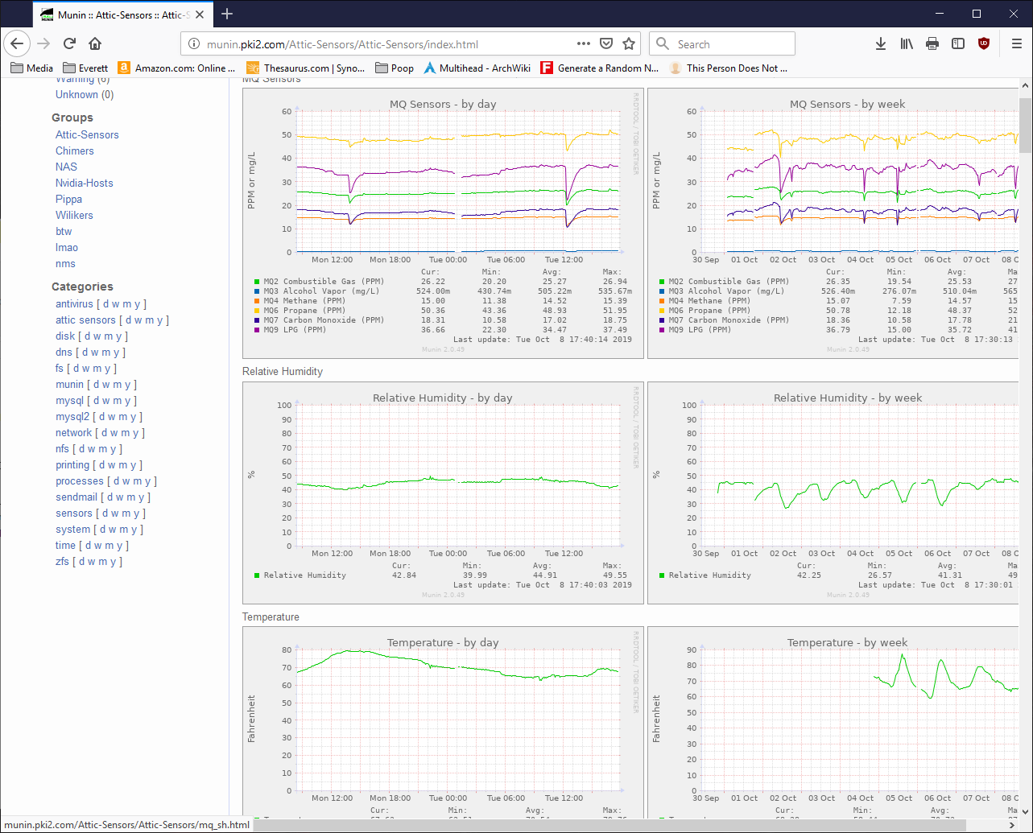
Munin Graphs
An example Munin graph during development. The gaps and valleys in the sensor readings are from testing code and restarting the application.

